Slide 1

Superstore Sales Performance Analysis
Strategic Insights into Regional Sales, Segments, and Top Products

Slide 2
Key Findings at a Glance
Regional Dominance: The West Region is currently the top revenue driver, outperforming other areas.
Segment Profitability: The "Consumer" segment generates the highest sales volume, but profitability varies across segments.
Top Products: "Phones" and "Chairs" are the leading sub-categories, contributing significantly to overall revenue.
Recommendation: Focus marketing efforts on the West region and optimize inventory for high-demand sub-categories like Phones.

Slide 3
Tech Stack & Workflow
  Data Source: Sample Superstore Dataset.
  SQL (Google BigQuery): Used for data extraction, cleaning, and aggregation.
  Tableau: Used for data visualization and trend analysis.
  Process:
    Uploaded raw CSV data to BigQuery.
    Executed SQL queries to aggregate sales by Region, Segment, and Category.
    Exported processed data to Tableau for final visualization.

Slide 4
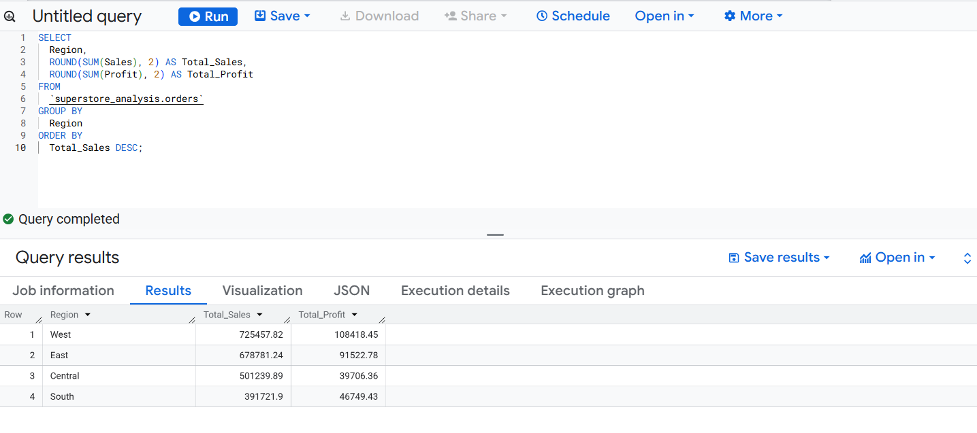
Data Extraction via SQL
Below is an example of the SQL query used to analyze Regional Sales performance.
Caption: Query: Aggregating Total Sales and Profit by Region.

Slide 5
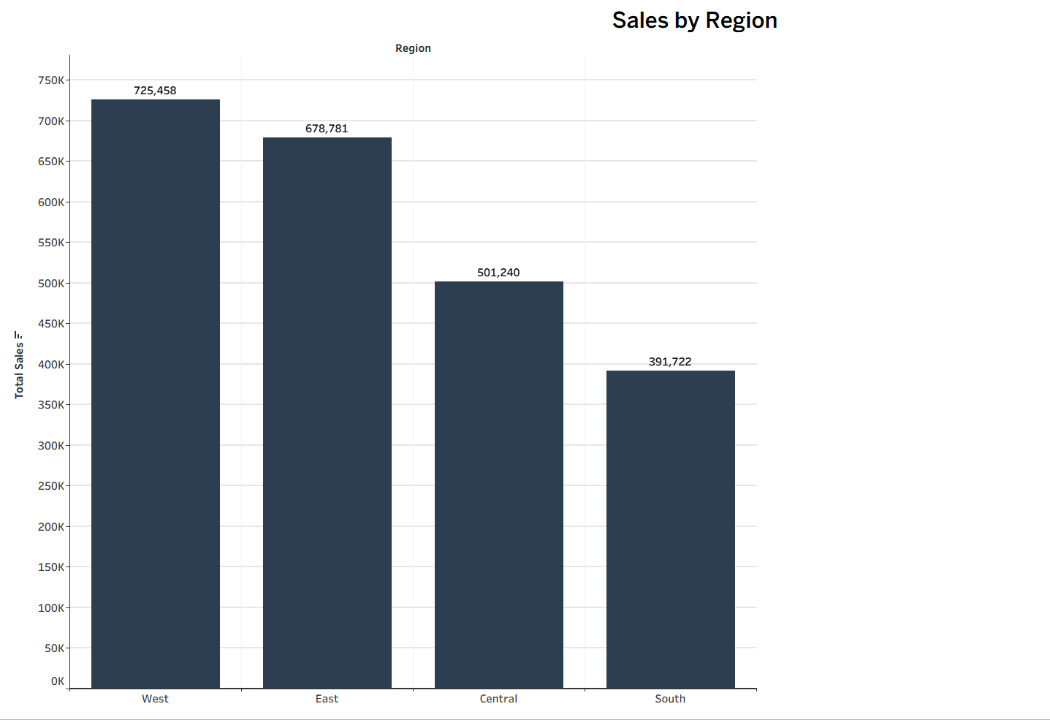
Sales Performance by Region
Insight:
The West region leads in total sales, followed closely by the East.
The South region currently has the lowest sales volume, indicating a potential area for targeted marketing campaigns to boost growth.

Slide 6
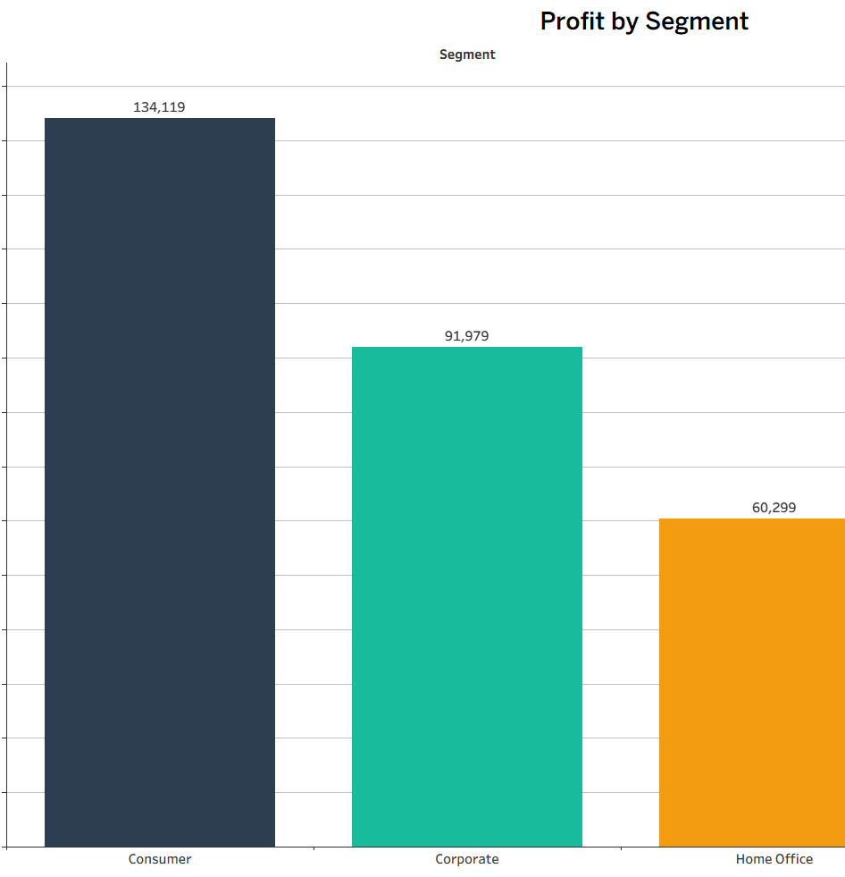
Profit Analysis by Customer Segment
Insight:
The Consumer segment is the most profitable, indicating that individual buyers are the core revenue stream.
Corporate clients provide steady profit, while the Home Office segment is smaller but highly efficient.
Strategy: Maintain loyalty programs for Consumer clients while exploring B2B opportunities in the Corporate sector.

Slide 7
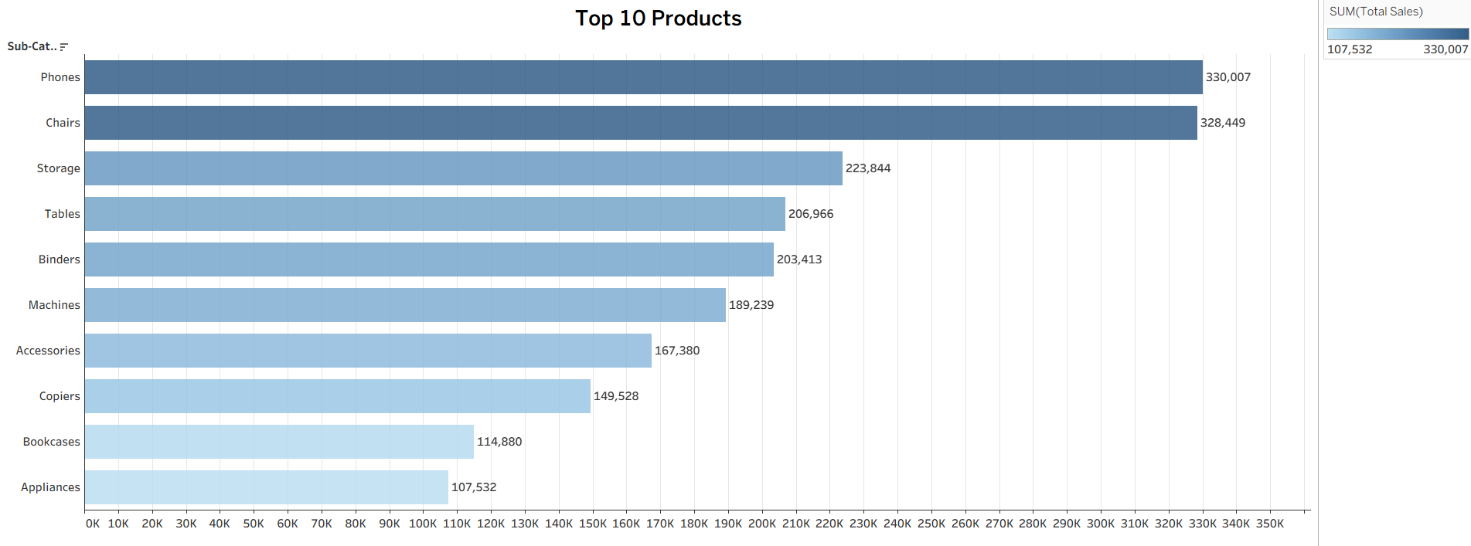
Top 10 Best-Selling Sub-Categories
Insight:
Phones and Chairs are the top-performing categories by revenue.
Office supplies like Binders and Paper have high transaction volume but lower revenue per unit.
Inventory Note: Ensure stock levels for Phones and Chairs are prioritized to prevent stockouts during peak seasons.

Slide 8
Strategic Recommendations
Double Down on the West: Invest 60% of the marketing budget into the West and East regions where ROI is proven.
Product Focus: Bundle "Phones" with accessories to increase average order value.
Segment Growth: Launch a retention campaign for the "Consumer" segment to maximize lifetime value.
Call to Action: Further analysis recommended on "Discount Impact" to see if lowering discounts increases overall profit margins.

